Slide 1


Cover Page
BIG GAME CENSUS VISUALIZATION
WIREFRAME DOCUMENTATION
BY :
HIMASREE RAMINI

Slide 2
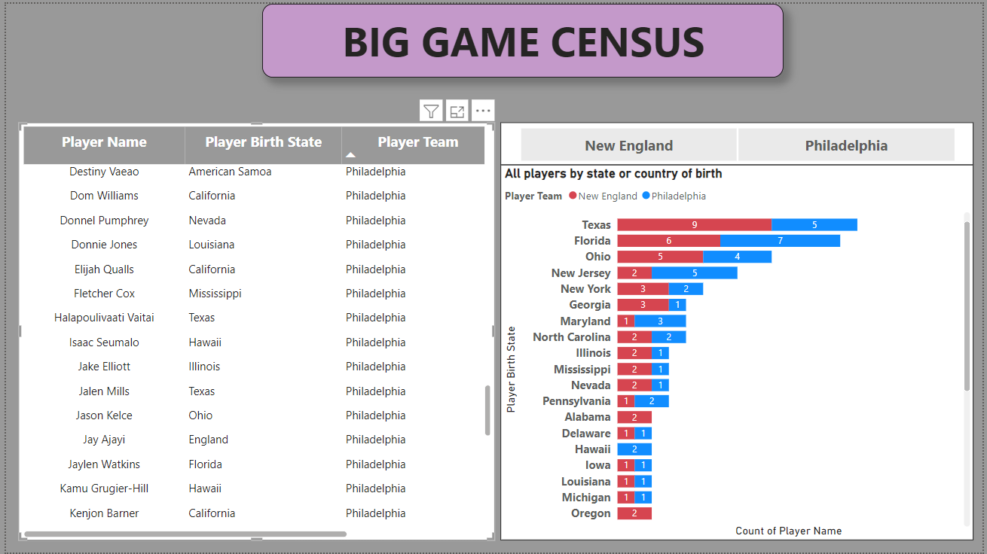
Dashboard:

Slide 3
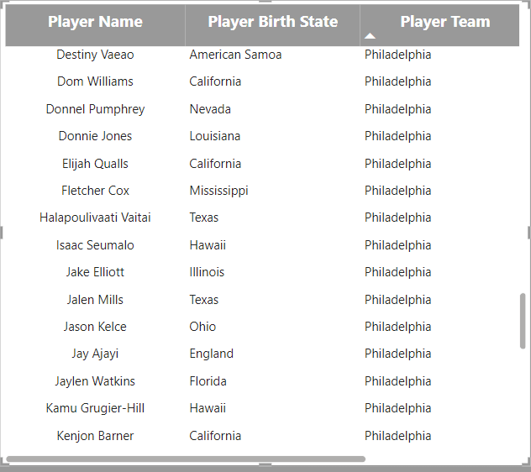
GAME INSIGHTS:

Slide 4
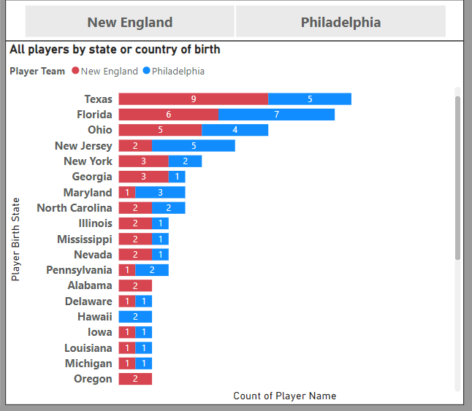
COUNTRY WISE ANALYSIS:

Slide 5
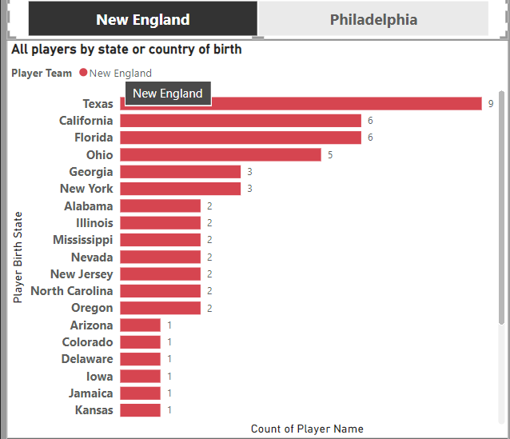
NEW ENGLAND ANALYSIS:

Slide 6
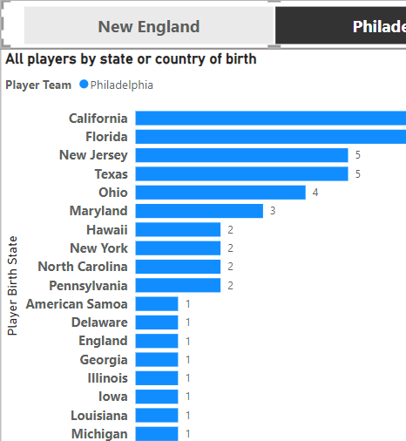
PHILADELPHIA COUNTRY ANALYSIS:

Slide 7
Conclusion:
This project tells about the game census analysis and visualization . This makes us to give the overview on a game and countries gaming power
We can conclude many of the players are from the California and Texas as well.
Big game is encouraged by these countries so that many players were belongs to the countries new England and Philadelphia.

